Slide 1
HEWITT & MCLEOD
Working Together To Improve Your Cash Flow

Slide 2
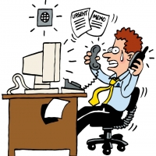
1.Debt Recovery: How it can work for you
EFFECTIVE ESCALATION
INVOICES PAID QUICKER
IMPROVED CASHFLOW
TIME BACK FOR OTHER PROJECTS
POSITIVE CUSTOMER RELATIONSHIPS
BUSINESS CREDIBILITY
A TRUSTED & EFFECTIVE PARTNER

Slide 3
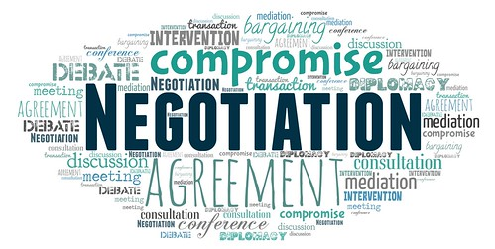
2. Debt Recovery: Securing payment
DATA VALIDATION – KYC
MAKING CONTACT
EFFECTIVE COMMUNICATION
SECURE PAYMENT
NEGOTIATION
OVERCOMING OBJECTIONS
FOLLOW UP

Slide 4
3. Debt Recovery: Summary
Sector: Fashion / Communication & Marketing / Plant Hire / Recruitment / Office Equipment / Admin Support Services
Location: UK / Spain / France / Portugal / USA / Germany / UAE / USA
Common Theme: Prompt & accurate billing / strict payment terms / early intervention / clear escalation for non-payers

Slide 5
Final thought….
“If you’re not serious about your payment terms then how can you expect your customer to be?”

Slide 6
HEWITT & MCLEOD
Working Together To Improve Your Cash Flow
linkedin.com/in/iain-mcpherson-increasecashflow
Telephone: 0141 266 0163
Mobile: 07401436801
Email: iain@hewittmcleod.com
Web: www.hewittmcleod.com

